Slide 1

Basic Details of the Team and Problem Statement
Ministry/Organization Name/Student Innovation: Government of Kerala
PS Code: SIH1324
Problem Statement Title: Air and Water Quality Index and Environment Monitoring
Team Name: DSDynamos
Team Leader Name: K Thrishank
Institute Code (AISHE): C - 26902
Institute Name: Madanapalle Institute of Technology & Science
Theme Name: Environment Monitoring
1

Slide 2
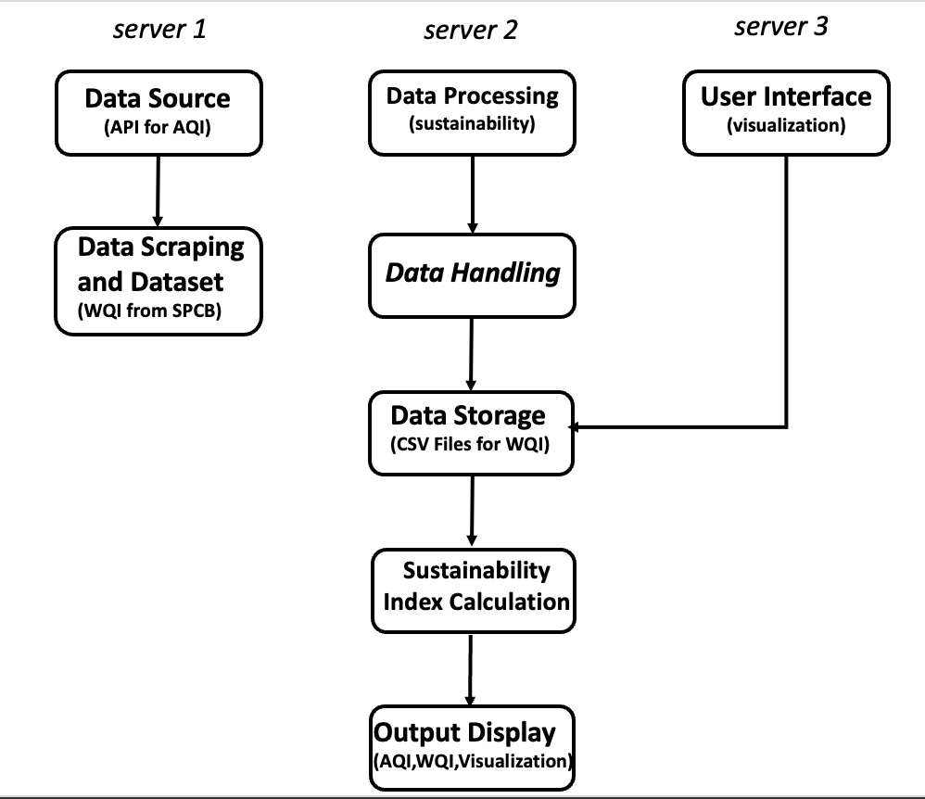
Environment Monitoring
Workflow:
Idea:
Developing an environmental monitoring system using external daily AQI and monthly WQI data, incorporating real-time scraping and CSV integration, to generate a Sustainability Index for assessing and visualizing location-specific environmental conditions.
Approach:
We fetch daily Air Quality Index (AQI) data from aqi.in using APIs and gather monthly Water Quality Index (WQI) data from the State Pollution Control Board (SPCB).
Later processing the real-time AQI data and maintain daily updates.
By storing and updating monthly WQI data in CSV format makes WQI indexing easy.
We display AQI, WQI values, and calculate a Sustainability Index for environmental assessment and providing a user-friendly visualizations for easy understanding.
We employ a K-Means Algorithm technique for predictive reports in case of data source uncertainties.
Technologies
Data Analytics & Techniques
ReactJS
Machine Learning
Beautiful Soap
2

Slide 3
Details
Use Cases:
Dependencies:
1 – Public Awareness & Education
2 – Health Alerts & Protection
3 – Agriculture & Irrigation
4 – Drinking Water Safety
5 – Environmental Protection Agency(EPA)
6 – Emergency Response
1 - Air & Water Quality Parameters
2 - Index Calculation Methodology
3 - Air & Water Quality Index Categories
4 - Data conversion
5 - Quality Assurance/Quality Control
6 - Continuous Control Monitoring
3

Slide 4
Team Member Details
Team Leader Name: K Thrishank
Branch : B.Tech Stream : CSE – Data Science Year (I,II,III,IV): III
Team Member 1 Name: P Yasin Khan
Branch : B.Tech Stream : CSE – Data Science Year (I,II,III,IV): III
Team Member 2 Name: I Sree Manogna
Branch : B.Tech Stream : CSE – Data Science Year (I,II,III,IV): III
Team Member 3 Name: P Thejaswini
Branch : B.Tech Stream : CSE – Data Science Year (I,II,III,IV): III
Team Member 4 Name: P Shiva Kumar Goud
Branch : B.Tech Stream : CSE – Data Science Year (I,II,III,IV): III
Team Member 5 Name: M Sandeep
Branch : B.Tech Stream : CSE – Data Science Year (I,II,III,IV): III
Team Mentor 1 Name: Mr. K.Durga Charan
Category (Academic/Industry): Academic Expertise : IoT & Cloud Computing. Domain Experience (in years): 8

